Slide 1

Genetic Programming
Project Presentation

Slide 2
Final System Design
Shuo Yang

Slide 3
Final System Design
Phase 1
Phase 2
Phase 3
Notes:
About design details, I’ll not talk about everything, instead I’ll focus on some important points.

Slide 4
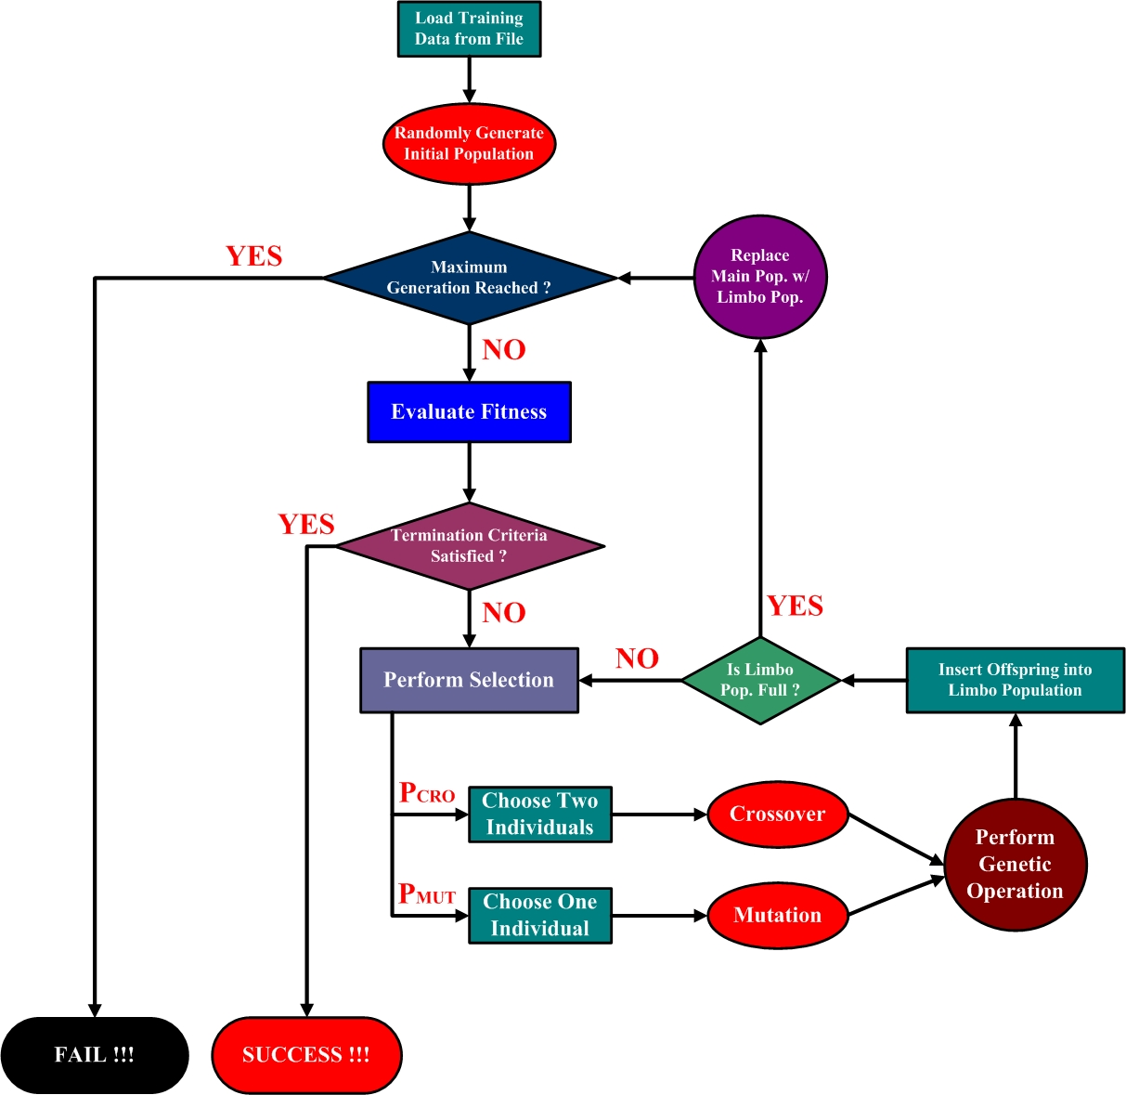
System Flow Chart of Phase 1

Slide 5
Design Details in Phase 1
Representation of individuals
Ensure diversity of population
Handling “divided by zero”
Notes:
There are some critical design details worth mention in phase 1, in phase 1, I kind of simplify the design, first design a small but functional system

Slide 6
Representation of individuals
struct node {
struct node * left;
struct node * right;
int data;
};
( x * x + 3 ) / 2 :
struct node {
struct node * left;
struct node * right;
? ( what kind of data here ?)
};
/
3
+
2
0
2
But, in a tree node,
how can we represent these different symbols?
×
3
2
1
x0
x0
0
0
Table of Operators :
Table of Operands :
+ | – | × | /
0 | 1 | 2 | 3
x | c1(3) | c2(2) | ……
0 | 1 | 2 | ……
Notes:
We use binary tree to represent an individual, seems straightforward, but when we start writing the code, we have to ask such question:
First, I wanted to use string, but each time we get that string, we had to convert it to its real form, since GP did too many operations on the tree, its just a waste of resources.
In GP, expression tree has such features : all the non-leaf nodes are operators which we have only four choices. And all the leaf nodes are operands.

Slide 7
Ensure diversity of the initial population
Diversity should be one of the foundation of Genetic Programming
The Full Method:
The Grow Method:
Combine two methods together: Ramped-Half-Half

Slide 8
Handling “divided by zero”
/
/
x
0
5
0
Simply return 0

Slide 9
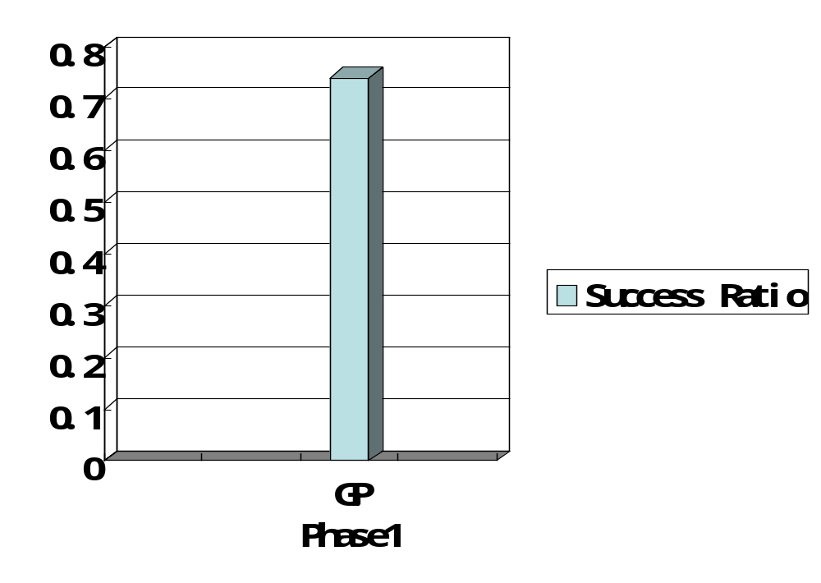
Success ratio of GP in phase1 (target function: (x*x + 3)/2 )

Slide 10
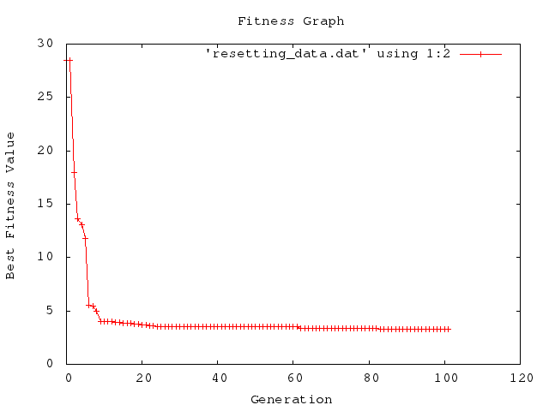
After running GP again and again, we find that GP tends to lose diversity along with the increase of generation number.
Notes:
That means our system needs to be improved.

Slide 11
Phase2
(with resetting of population)

Slide 12
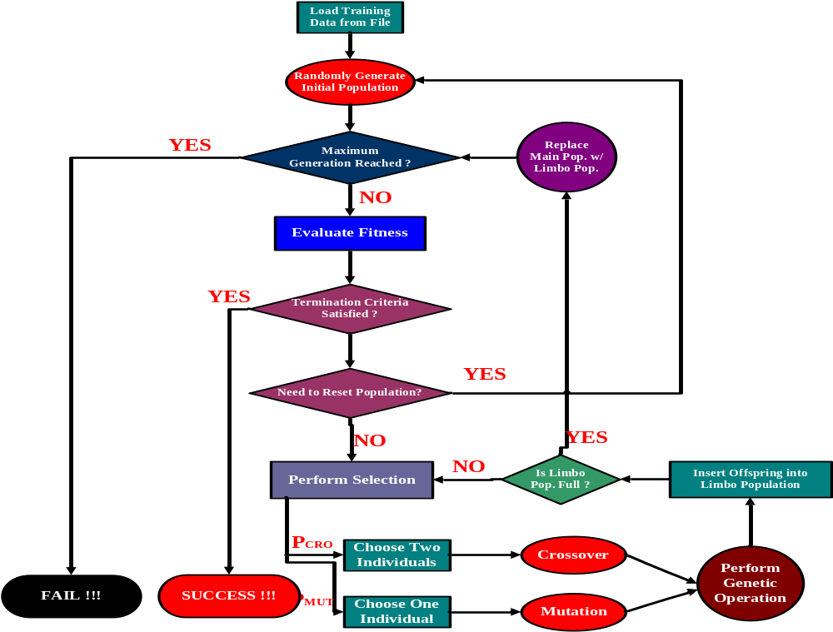

Slide 13
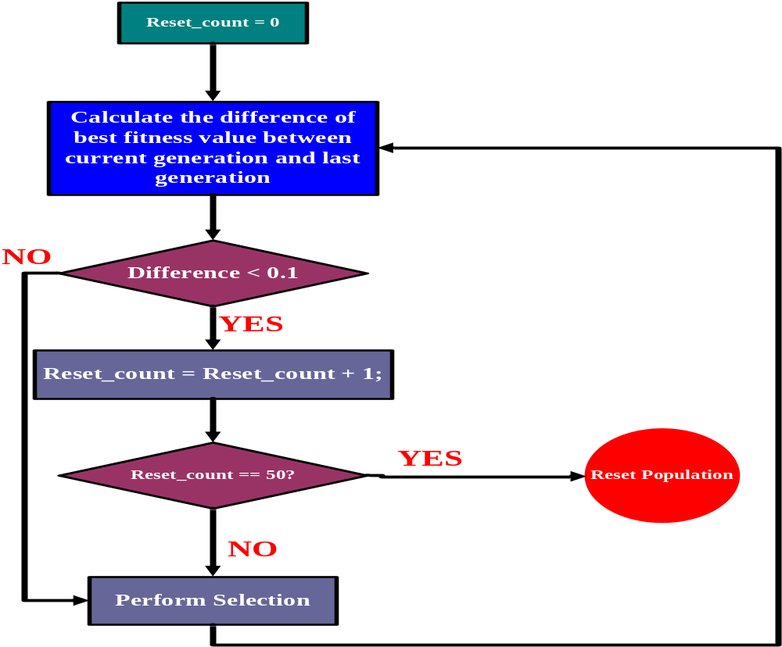

Slide 14
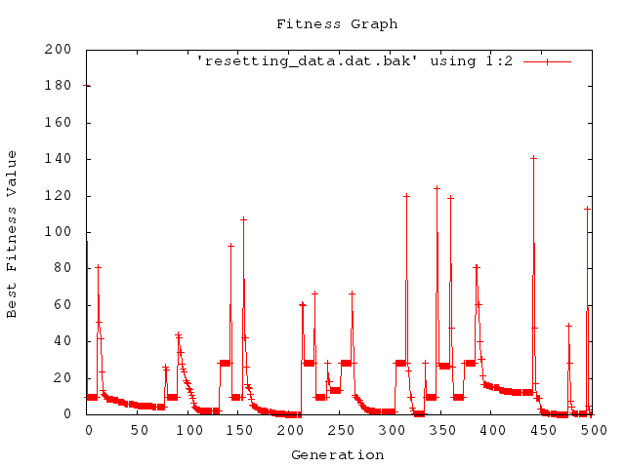
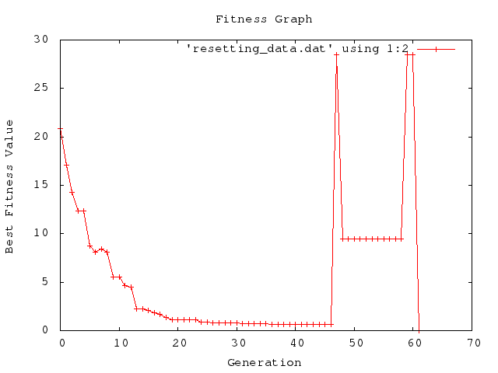

Slide 15
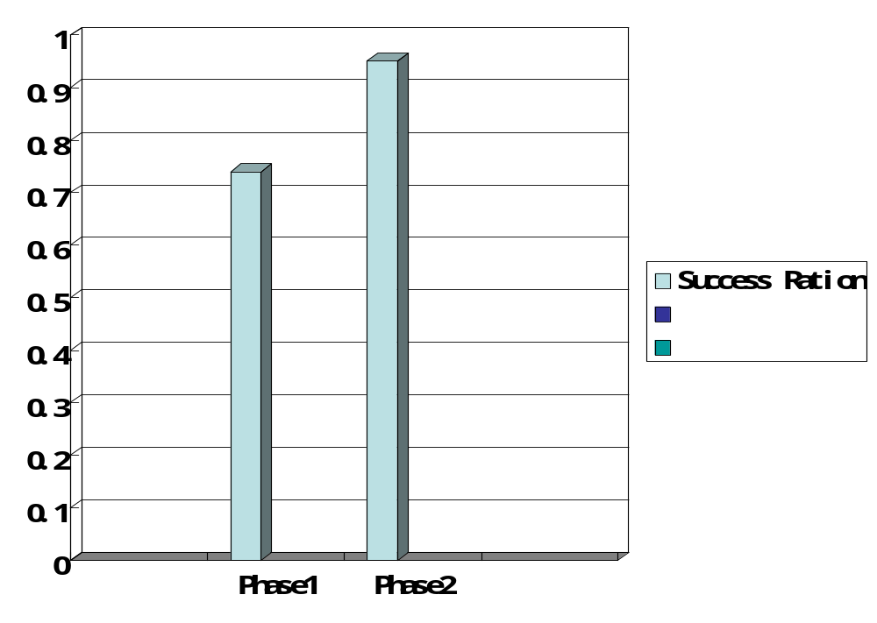
Success ratio of GP in phase1 and phase2
(target function: (x*x + 3)/2 )

Slide 16
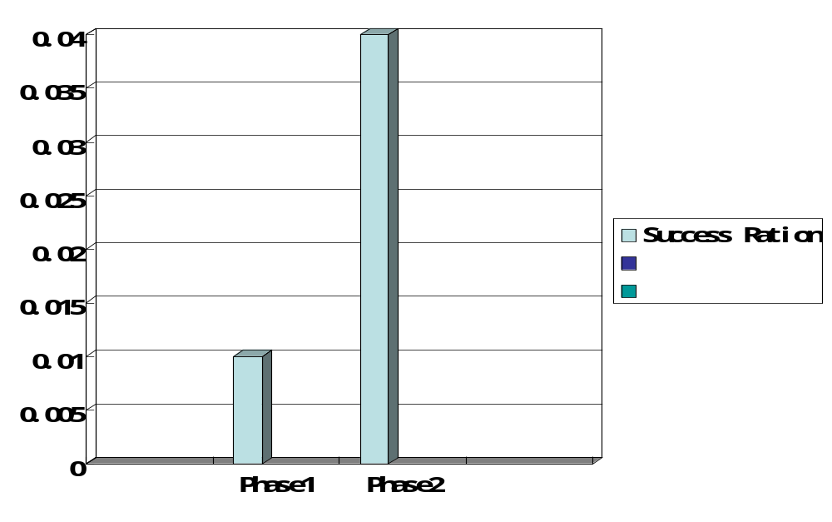
(x * x – 1) / 2
What if:
(35*x*x*x – 17x*x + 9*x -161) / 5
(x * x + 3) / 2

Slide 17
Problem with constants
GP is less efficient in finding appropriate numeric constant
The finding of numeric constants is a skeleton in the GP closet... [and an] area of research that requires more investigation. (Koza 1997)

Slide 18
Phase3
(with numeric mutation)

Slide 19
numeric mutation
Numeric mutation replaces all of the numeric constants with new ones in the individuals to which it is applied
The new numeric constants are chosen at random from a uniform distribution within a specific selection range
[value of constant, value of constant + temperature factor]
[value of constant - temperature factor, value of constant ]
temperature factor = best fitness * 0.02

Slide 20
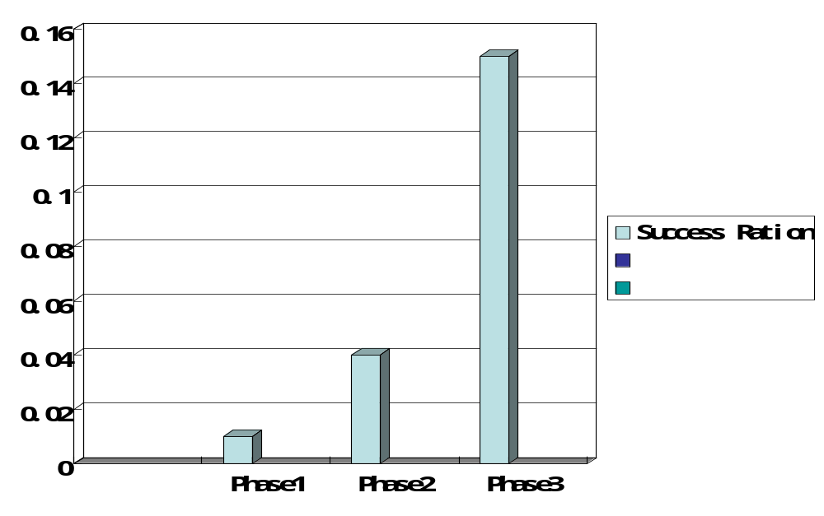
Success ration with target:
(35*x*x*x – 17x*x + 9*x -161) / 5

Slide 21
Several solutions for
(35*x*x*x – 17x*x + 9*x -161) / 5
(((((x0 - ((-1 / -5 )- (4 - (x0 / -2 ))))- (((x0 - x0 )* (x0 / (-36 * ((x0 - -2 )- -6 ))))* ((241 - -3 )* x0 )))- (((x0 - -3 )* x0 )* x0 ))+ -36 )- ((x0 * x0 )* (((241 * x0 )- ((-36 + ((x0 - -3 )* ((x0 - -3 )- -6 )))/ x0 ))/ -30 )))
(-1 - (54 - ((7 * ((x0 * (x0 * x0 ))+ 3 ))- (((((x0 * x0 )+ (x0 * x0 ))- x0 )+ (x0 * x0 ))- (x0 - ((((x0 * x0 )- 2 )+ ((x0 + (x0 * x0 ))- 7 ))/ 5 ))))))
(((((x0 - ((x0 - (-8 / 8 ))/ 5 ))- ((((((x0 * x0 )/ 5 )- x0 )- x0 )- -11 )- -11 ))- x0 )- 10 )+ (x0 * ((7 * (x0 * x0 ))- (x0 - (((x0 / -5 )- x0 )- x0 )))))

Slide 22
